Slide 1
Cost of living Analysis using Tableau
Presented by
Odiniya Princess Ojone

Slide 2
TABLE OF CONTENTS
01
04
02
05
03
Project Overview
Dashboard
Objectives
Insight
Interpretation of Results

Slide 3
This project analyses the cost of living in various cities and countries globally. The dataset comprises diverse economic indicators, including the prices of basic commodities, housing, transportation, and entertainment. By leveraging Tableau, the project aims to uncover insights into economic disparities between regions and identify factors contributing to the varying costs of living. This data visualisation, analysis, and interpretation exercise provides a comprehensive view of the global economic landscape.
Project Overview

Slide 4
Objectives
The objective of this project is to analyze and visualise the cost of living across various cities and countries using Tableau. The specific goals are:
Identify Cost Disparities: Determine cities and countries with the highest and lowest costs of living.
Analyze Cost Components: Examine key cost components such as housing, transportation, and groceries.
Correlate Economic Factors: Explore how factors like average salary and housing costs relate to the overall cost of living.
Detect Trends and Patterns: Identify trends and patterns in the cost of living data.
Support Strategic Decisions: Provide insights to aid in relocation, investment, and business expansion decisions.
This project aims to enhance understanding of the global cost of living variations and develop skills in data analysis and visualization using Tableau.

Slide 5
Interpretation of Results
Identify cities and countries with the highest and lowest costs of living based on various cost components.
Analyze the visualizations to derive meaningful insights about the cost of living across different regions.
Explore correlations between factors like average salary, housing costs, and transportation expenses to understand their impact on the overall cost of living.

Slide 6
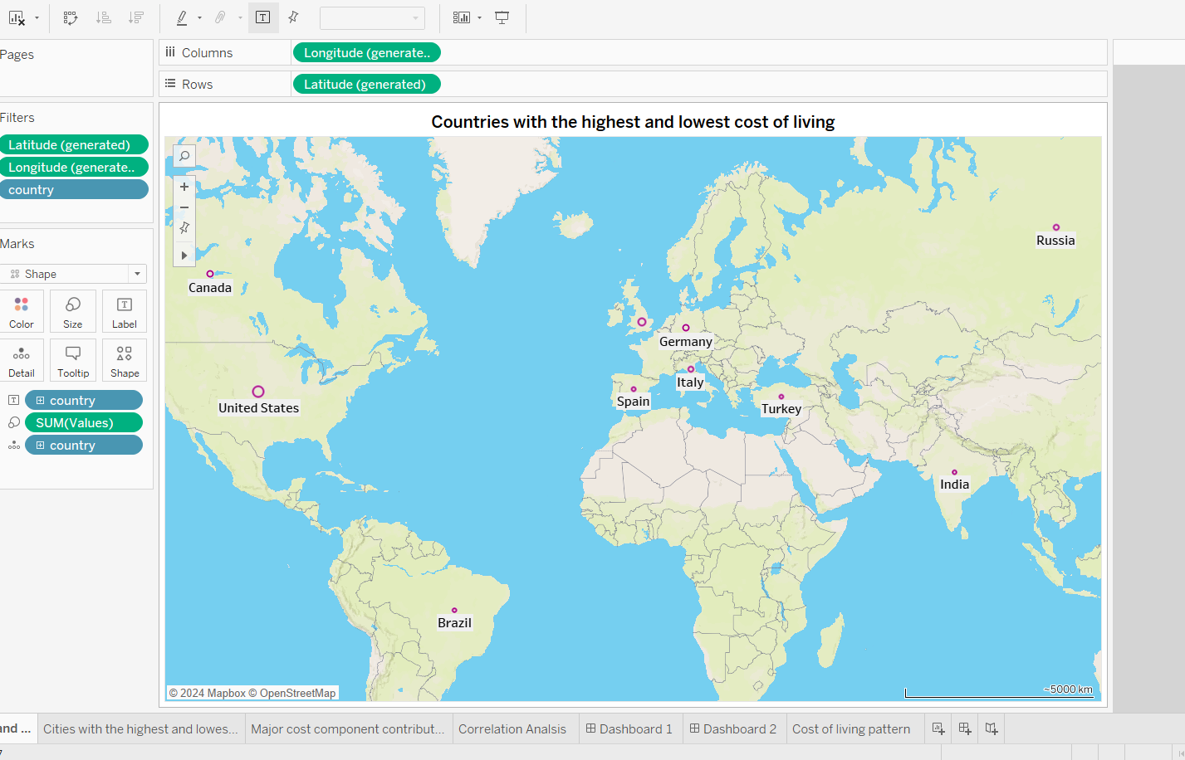
What are the cities and countries with the highest and lowest costs of living?
2010
2020
Based on the analysis, the most expensive country is the United States.
And still going strong!
Saturn is a gas giant and has several rings
Neptune is the farthest planet from the Sun

Slide 7
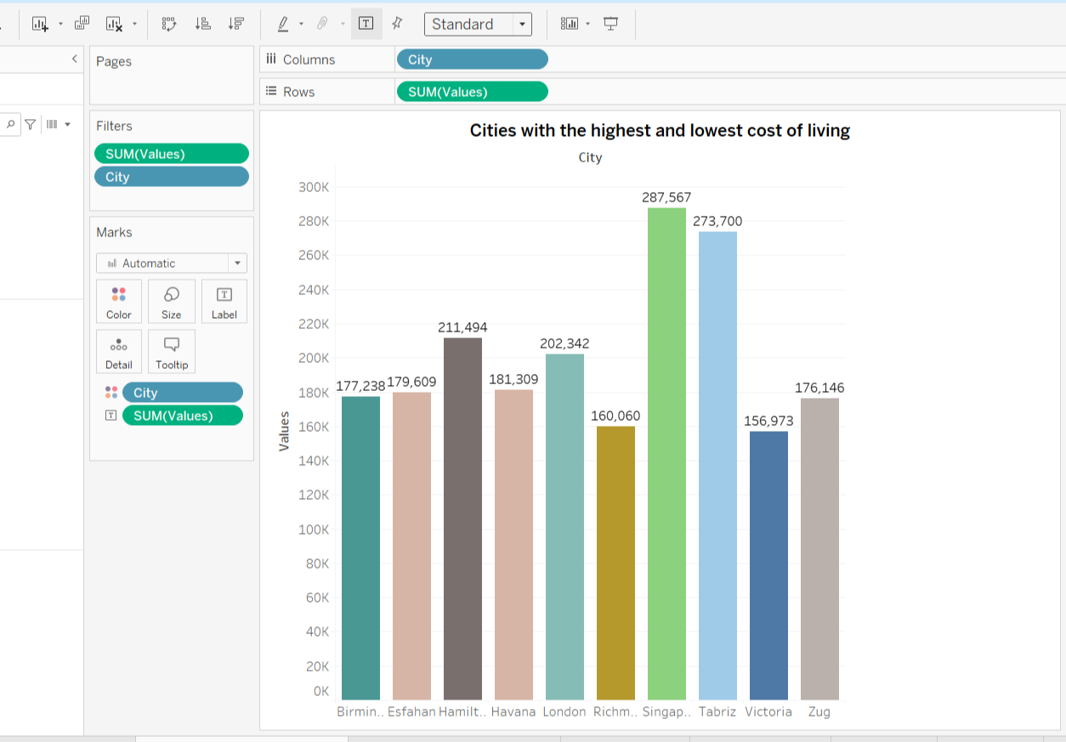
What are the cities and countries with the highest and lowest costs of living?
The least expensive Country is Afghanistan

Slide 8
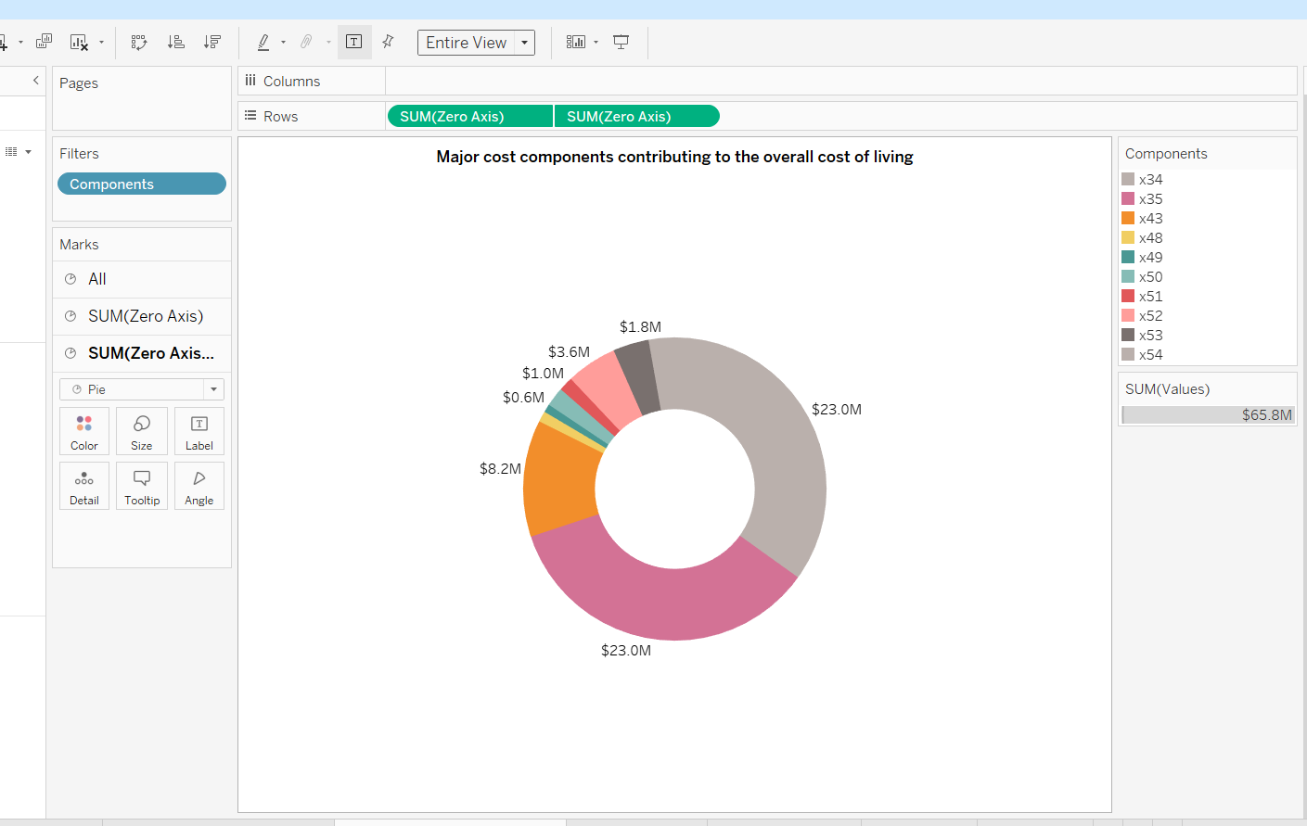
What are the major cost components contributing to the overall cost of living in a region?
The major components that contribute to the overall cost of living in a region are:
Volkswagen Golf 1.4 90 KW
Toyota Corolla sedan.
International primary school yearly for one child.
Price per Square Meter to Buy an Apartment in the City Centre.
Price per Square Meter to Buy an Apartment Outside of the Centre.
Apartment (3 bedrooms) Outside of Centre.
Apartment (1 bedroom) in City Centre.
Apartment (1 bedroom) Outside of Centre.

Slide 9
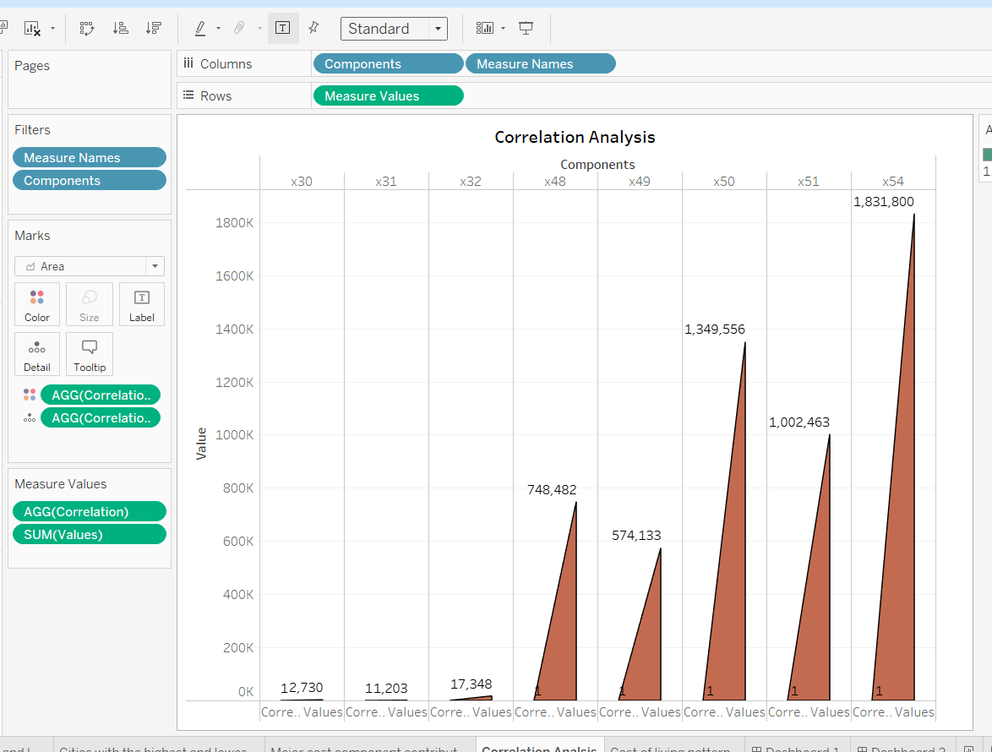
How do factors like average salary, housing costs, and transportation expenses correlate with the cost of living?

Slide 10
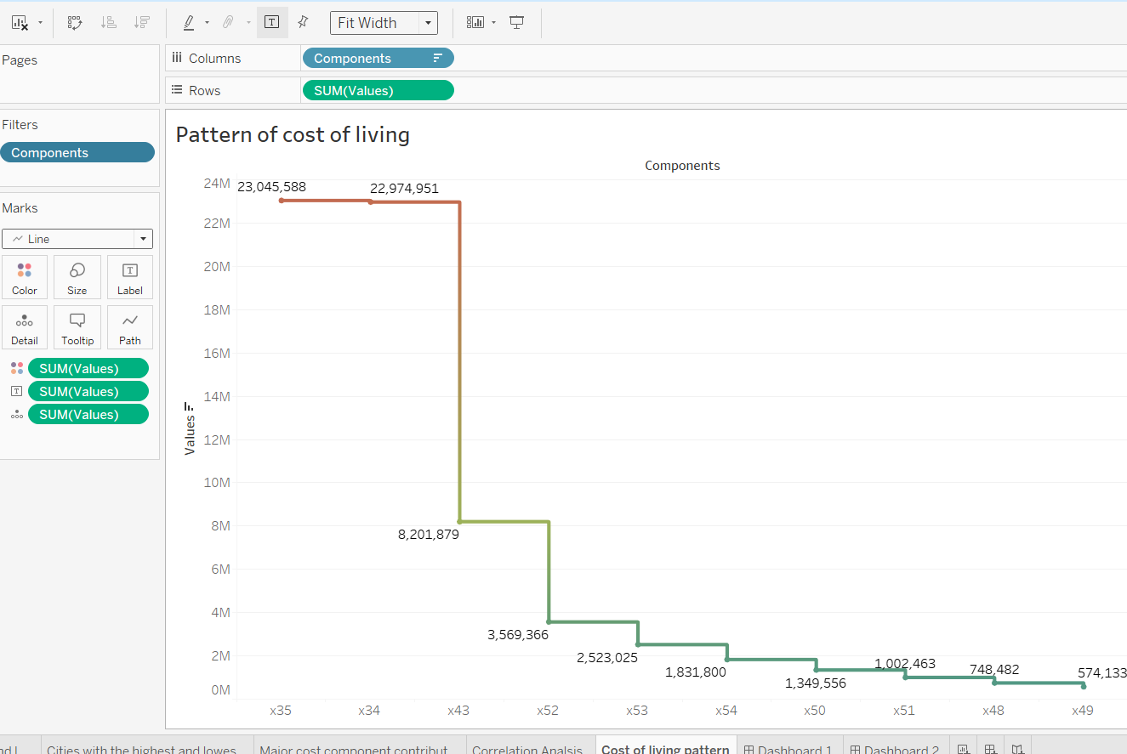
Are there any trends or patterns in the data that can help individuals and organisations make strategic decisions?
These insights can serve as valuable aids for individuals and organisations in formulating strategic decisions. Clear correlations and trends become apparent by examining factors such as housing costs, transportation expenses, and average salaries. For instance, cities experiencing a surge in housing costs may also witness a corresponding rise in other living expenses. Additionally, regions with higher average salaries tend to exhibit increased costs across various commodities and services.

Slide 11
Insight from the Analysis
The analysis highlights stark disparities in the cost of living between countries, with the United States identified as the most expensive and Afghanistan as the least expensive. Examining major cost components reveals that expenses related to housing, transportation, and education significantly influence overall living costs.
Notably, the cost of vehicles such as the Volkswagen Golf 1.4 90 KW and Toyota Corolla sedan, along with expenditures on education, particularly international primary school fees, contribute substantially to the overall cost of living. Additionally, housing costs, including prices per square meter for apartments both in city centres and outside areas, emerge as pivotal factors.
These insights provide valuable insights for individuals and organisations in crafting strategic decisions. By recognizing correlations between housing expenses, transportation outlays, and average incomes, stakeholders can make informed choices. For instance, regions experiencing surges in housing costs often witness corresponding increases in other living expenses. Furthermore, areas with higher average incomes typically exhibit elevated costs across various goods and services.

Slide 12

45,000
EMPLOYEES

